Slide 1
Welcome to the ICN Framework
Innovation Chain North
Overview

Slide 2
Agenda
The Team
ICN History
ICN Tender
Structure and Lots
Awards
How it works
Social Value
ICN Portal
What we do?
What you do?
Any questions?
Agenda

Slide 3
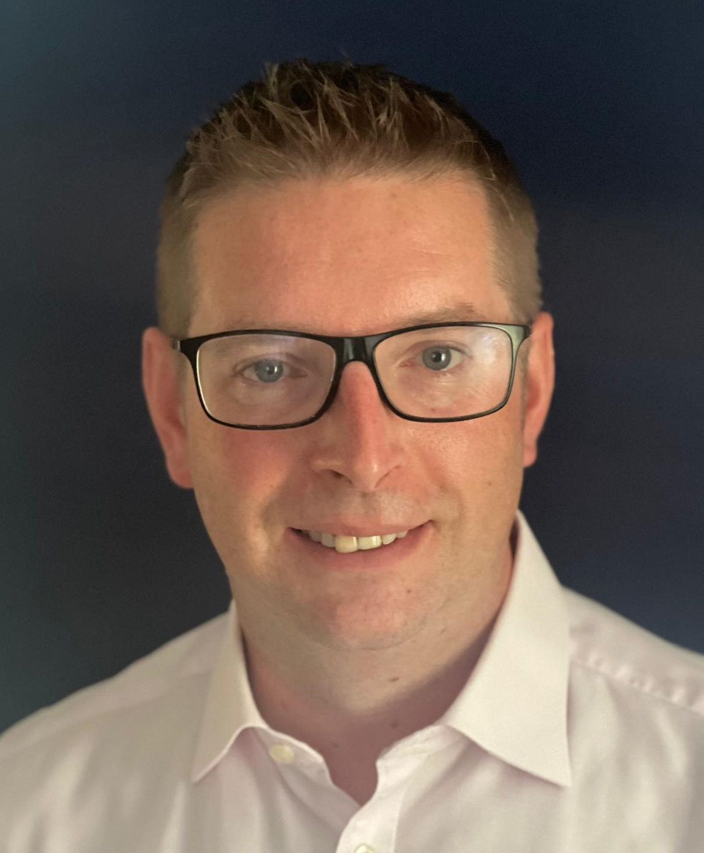
The ICN Team at Great Places
Joanne Whitehead (Development Performance Manager) | Nick Cumberland (Head of Programme) | Nick Gornall (Director of Development) | Bryan Simmons (Procurement Manager)
Responsible for managing the framework | Responsible for day-to-day senior leadership support | Responsible for senior leadership support | Responsible for Procurement Compliance

Slide 4
Innovation Chain History
Year | ICNW/ICN History
2012 | Innovation Chain North West (ICNW) principle founded by Great Places
2012-2016 | ICNW Framework jointly procured by GP, Adactus, Plus Dane and Harvest
2016-2020 | ICNW Framework solely procured by GP, serviced 17 clients. Between 2012 and 2020 in excess of 4000 new homes and expenditure of £400m+ has been procured through ICNW.
July 2020 | ICN Framework operational – 33 clients in June 2024. Throughput value of c£650m
July 2024 | ICN Framework 2024 – 2028 operational

Slide 5
ICN 2024 Tender
The £1.5bn tender was issued to the market in October 23, with a return date of Dec 23.
An increase of 23% in tender submissions from 19/20
Reflects the reputation and value placed on ICN.
Evaluation of over 800 bids were evaluated by GP development team and other existing ICN clients.
All tender submissions were evaluated using the Lot criteria as follows:
Lots | Price | Quality | Social Value
Contractors | 40% | 50% | 10%
Professional Services: C1 – C7, C10 & C11 | 40% | 50% | 10%
Professional Services: C8 – C9 | 30% | 60% | 10%
Notes:
You’ve heard some of the headline numbers around delivery through the framework, and wanted to take a few minutes to bring it to life through a couple of case studies.
What we need to keep reminding ourselves – and our wider teams, is that our work is much more than just numbers - for every new home which we are building – we will be making a massive positive impact for our customers – this is likely to become even more important given the challenges in the economy as a whole
First scheme is a One Manchester scheme at Mayton Street, Openshaw – a small scheme delivered through the low value lot
John Southworth and One Manchester worked collaboratively delivering twenty one, 2 and 3 bedroomed homes for shared ownership and social rent in Openshaw, Manchester - just two miles from the city centre of Manchester
The development sought to provide the optimum balance of cost, efficiency and design to deliver these homes affordably whilst reducing running costs for the occupant and the carbon impact of these homes
This is an award winning development which has been recognised as an excellent example of integrating mixed tenure development whilst creating robust, high quality and vibrant new homes into the community
Alongside this, 9% of Social Value return has been delivered, including:
• Supporting 16 work placements
• Employing and supporting 5 Apprentices
• The full refurbishment and repair of a local play park
• Supported St Barnabas Primary School with the donation of prizes for their Summer Fair and
• Promoted construction as a career choice at a local career fair

Slide 6
ICN 2024 to date
Framework went live August 2024
New framework has 69 consultants and 34 contractors
New portal has been built to support the new framework
As of 18th September, 9 clients have joined with 15 more in the process of signing the access agreement
Notes:
You’ve heard some of the headline numbers around delivery through the framework, and wanted to take a few minutes to bring it to life through a couple of case studies.
What we need to keep reminding ourselves – and our wider teams, is that our work is much more than just numbers - for every new home which we are building – we will be making a massive positive impact for our customers – this is likely to become even more important given the challenges in the economy as a whole
First scheme is a One Manchester scheme at Mayton Street, Openshaw – a small scheme delivered through the low value lot
John Southworth and One Manchester worked collaboratively delivering twenty one, 2 and 3 bedroomed homes for shared ownership and social rent in Openshaw, Manchester - just two miles from the city centre of Manchester
The development sought to provide the optimum balance of cost, efficiency and design to deliver these homes affordably whilst reducing running costs for the occupant and the carbon impact of these homes
This is an award winning development which has been recognised as an excellent example of integrating mixed tenure development whilst creating robust, high quality and vibrant new homes into the community
Alongside this, 9% of Social Value return has been delivered, including:
• Supporting 16 work placements
• Employing and supporting 5 Apprentices
• The full refurbishment and repair of a local play park
• Supported St Barnabas Primary School with the donation of prizes for their Summer Fair and
• Promoted construction as a career choice at a local career fair

Slide 7
Framework Structure
The ICN framework covers the North of England, from Cumbria and Northumberland in the north to Lincolnshire, Cheshire and Staffordshire in the south
ICN has 11 contractor lots and 13 consultant lots

Slide 8
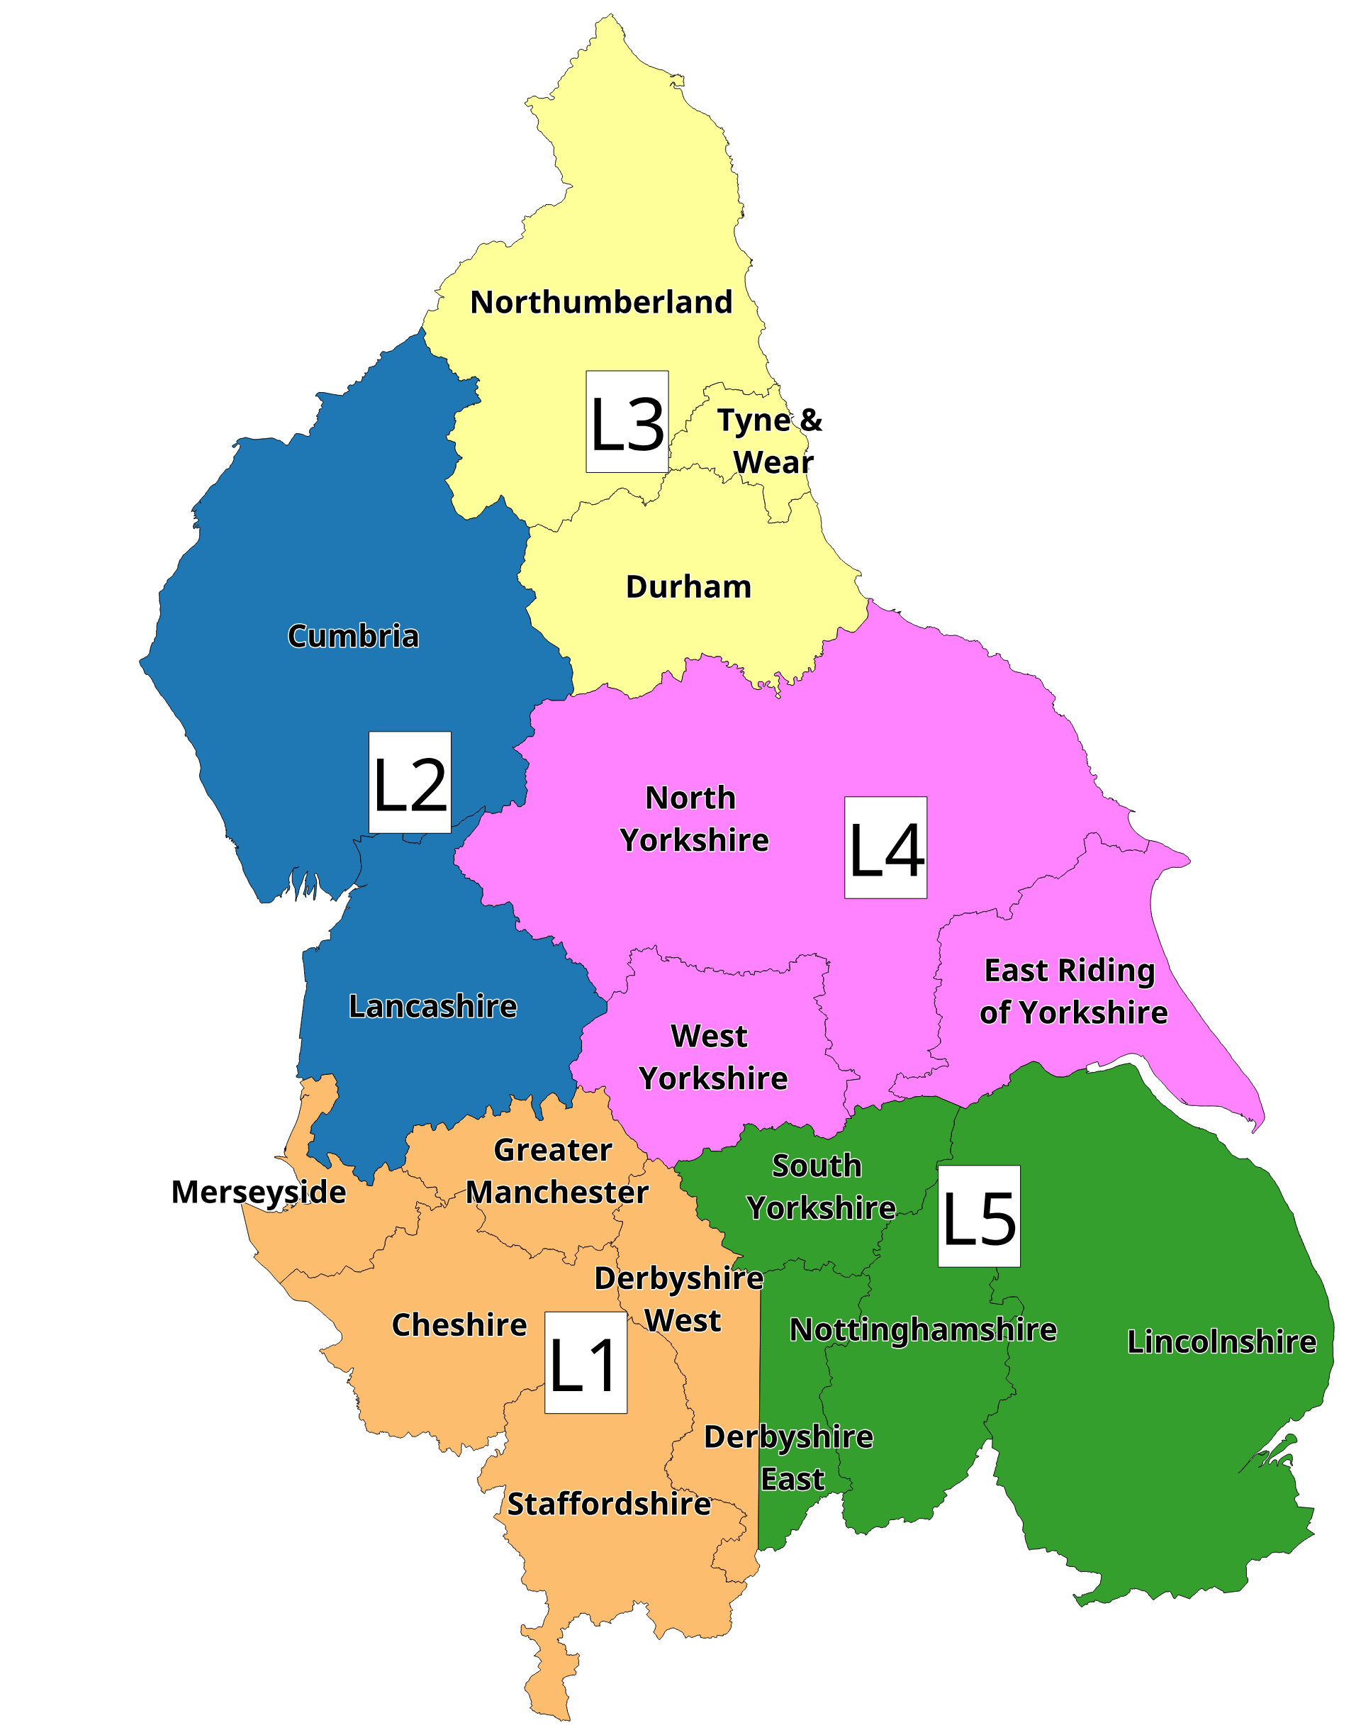
Contractor Low Value
Value banding up to 34 homes across 5 low value lots
All other low value geographic lots remain the same
Low Value Up to 34 Homes | Lot Number | Geographic Area
 | L1 | Greater Manchester and Merseyside, Cheshire, Derbyshire West and Staffordshire
 | L2 | Lancashire and Cumbria
 | L3 | Northumberland, Tyne & Wear and Durham
 | L4 | North Yorkshire, West Yorkshire & East Yorkshire
 | L5 | South Yorkshire, Derbyshire East, North Nottinghamshire & Lincolnshire

Slide 9
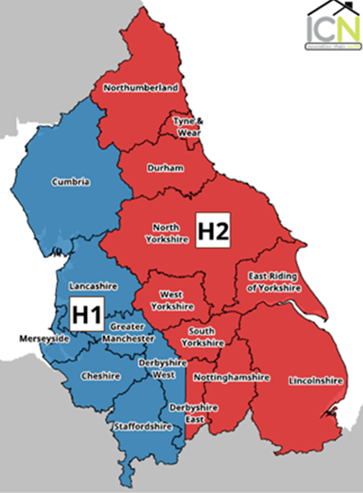
Contractor high value lots
High Value 35 homes & above | Lot Number | Geographic Area
 | H1 West | Greater Manchester, Merseyside, Cheshire, Staffordshire, Derbyshire West, Lancashire and Cumbria
 | H2 East | North Yorkshire, West Yorkshire , East Yorkshire, South Yorkshire, Derbyshire East, North Nottinghamshire, Lincolnshire, Northumberland, Tyne & Wear and Durham.

Slide 10
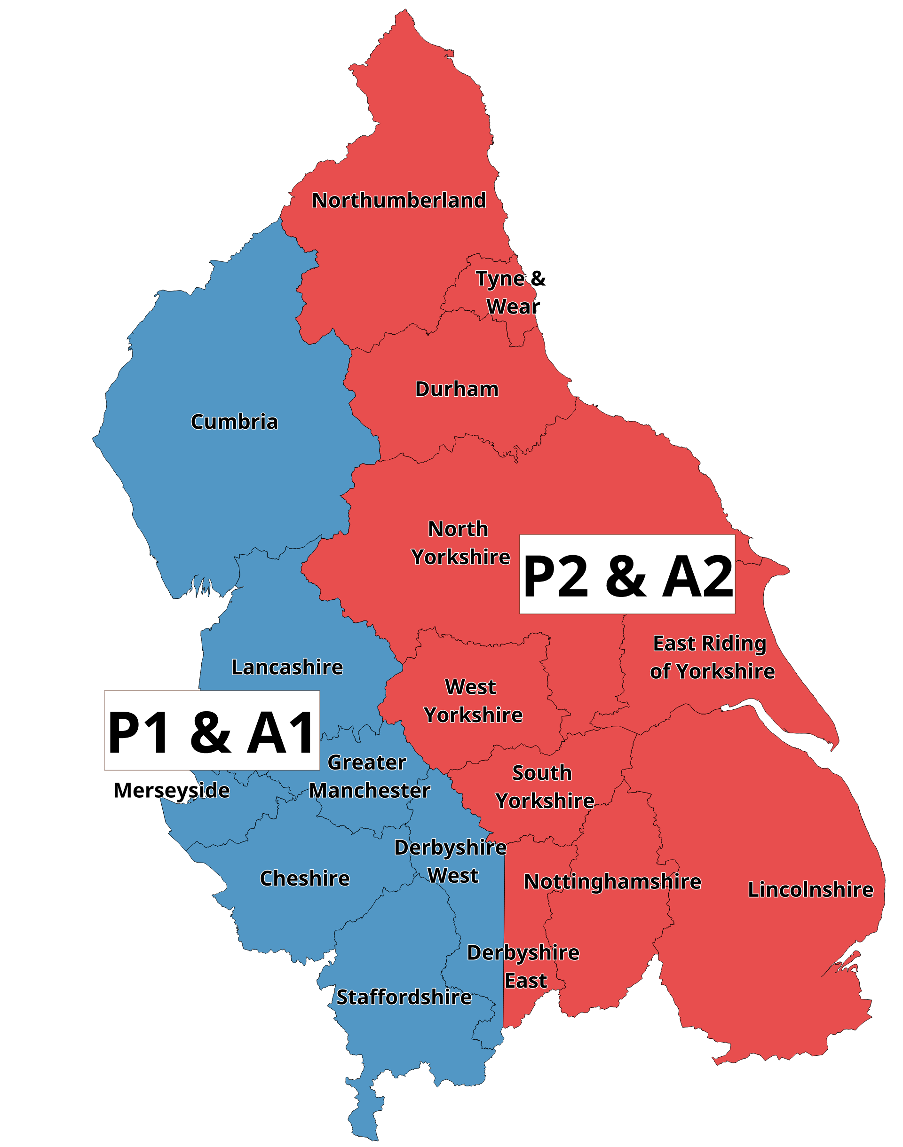
Other Contractor Lots
 | Lot No. | Geographic Area
MMC Contractors | P1 West | Greater Manchester, Merseyside, Cheshire, Staffordshire, Derbyshire West, Lancashire and Cumbria
 | P2 East | North Yorkshire, East Yorkshire, West Yorkshire, South Yorkshire, Derbyshire East, North Nottinghamshire, Lincolnshire, Northumberland, Tyne & Wear and Durham
Apartment specialist contractors | A1 West | Greater Manchester, Merseyside, Cheshire, Staffordshire, Derbyshire West, Lancashire and Cumbria
 | A2 East | North Yorkshire, East Yorkshire, West Yorkshire, South Yorkshire, Derbyshire East, North Nottinghamshire, Lincolnshire, Northumberland, Tyne & Wear and Durham

Slide 11
Consultant Lots
Lot Number | Professional Service
C1a | Employers Agent, Cost Consultancy & related services
C1b | Employers Agent, Cost Consultancy & Principal Designer Combined
C2 | Engineering Consultancy
C3 | Building Surveying
C4a | Architectural Services
C4b | Architectural Services & Principal Designer Combine
C5 | Clerk of Works
C6 | Purchasers Agent
C7 | Principal Designer & Health Safety Advisor
C8 | Planning Consultancy
C9 | Site Investigation Services
C10 | M&E Engineer
C11 | Retrofit Consultants

Slide 12
How it works?

Slide 13
How will work be awarded?
Clients will “call off” contractors and consultants from the framework
They can either make selection by direct award or by mini competition

Slide 14
Call off Process – Direct Award
Direct award is based on the client’s unique requirements, so clients choose which consultant and/or contractor would be most suitable to deliver each project. Selection of consultants and contractors will be monitored by the ICN team and a we will aim to achieve a balanced allocation of work
All call offs are to be made through the portal
All contractors and consultants will receive an email notification from the ICN portal when they have been called off. The call off notification will advise of the tendered fee, the social value pledge and confirm ICN insurance requirements are met
The client will then make direct contact with the contractor and/or consultant

Slide 15
Call off Process – Mini Competition
Contractor and consultant selection may be made by Mini Competition following the procedures set out in the Framework Agreement.
All Contractors and Consultants on the specific Lot will be invited to tender.
The client will determine the evaluation criteria.
The invitation to tender will be issued through the ICN portal and will include clear details on who to return the tender to. The tender will then be led by the client and/or EA.
When a successful Consultant and/or Contractor has been selected, the information needs to be uploaded to the portal.

Slide 16
What happens after call off – The Client
The Client will make contact with the supplier to take the scheme forward
Complete and enter into allocation letters/JCT contracts
Complete KPI forms at start on site and practical completion
Track social value delivered and complete the social value outcomes form
Submit case studies for uploading onto the website
Ensure scheme information on the portal is kept up to date, including aborted schemes
Ensure all call offs and mini comps are issued through the portal. It is not compliant with Procurement Regulations if it isn’t

Slide 17
What happens after call off – Consultants and Contractors
Contractors will be appointed by entering into the ICN JCT contract with the client
Consultants will be appointed by entering into the standard allocation letter
All consultants and contractors are required to
Respond to call offs and mini comps issued through the portal
Upload valid insurance documents and accounts (contractors only) to the portal

Slide 18
What happens after call off – Employers Agents
Employers Agents will also be required to:
Complete scheme costs analysis forms so we can share benchmarking data
Complete Tender summary forms for mini comps

Slide 19
Social Value How it Works
Key commitments for ICN
All suppliers pledged as part of your tender, based on National Toms Framework
Client and Consultants and/or Contractors advised of Social Value pledge at each call off stage
Client works with Consultants and/or Contractors to ensure full Social Value outcomes are delivered that benefit residents and the community.
Social value outcomes to be tracked and uploaded to the portal

Slide 20
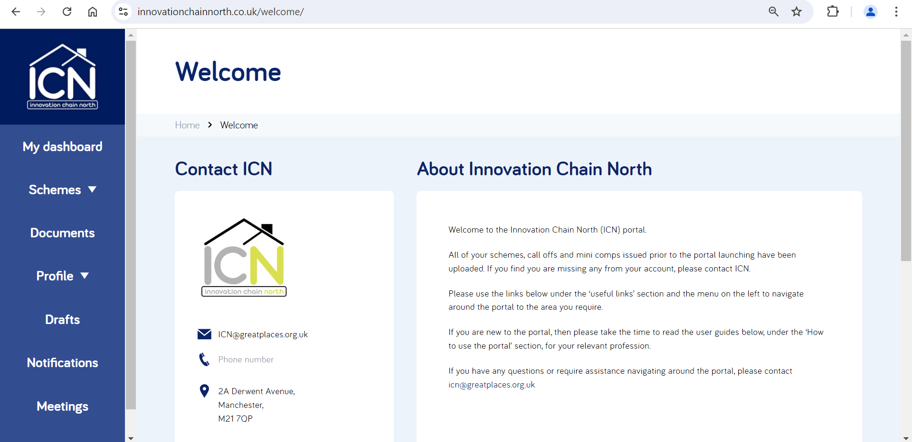
ICN Portal

Slide 21
ICN Portal
You can access the self–service ICN portal at innovationchainnorth.co.uk
All contractors, consultants and clients have access to different areas on the portal
Second framework using our fully integrated Portal; documents available include:
List of contractors and consultants on each lot
Call off documentation
Consultants allocation letter; service briefs and KPI workbooks
JCT contracts
Employers Requirements
Standard House Types
Contractor pricing schedules (restricted to EA access only)
Social Value tool
ICN Benchmarking data
Contact details for clients, contractors and consultants
Framework documentation

Slide 22
What Great Places will do
Ensure compliance with The Public Contracts Regulations 2015
Monitor workloads with the aim that all suppliers receive work through ICN
Arrange meetings in face-to-face or via Teams with contractors and consultant lots to check in, raise issues, share learning and keep you updated
Manage the ICN portal including call offs and mini competitions and ensure all documentation is kept up to date
Promote work and achievements through the website by sharing case studies and good news stories
Monitor social value outcomes and share the data with members of ICN
Provide cost benchmarking data
Monitor performance through KPIs
More detail in the Access Agreement

Slide 23
What we need from you
Attend meetings you are invited to; keep updated; share learning; share innovation ideas; provide open and honest feedback
Follow the compliant call off process. If the automated service on the portal is not completed the award/selection is not compliant
Ensure framework documentation is provided, including scheme cost analysis forms (EAs); KPIs and social value outcomes
Share good news stories and case studies that we can include on the website.
More detail in the Access Agreement
Mention us in your Social Media posts. Follow us on twitter @ICN_framework and LinkedIn @Innovation Chain North

Slide 24
For more information and questions
Visit… https://innovationchainnorth.co.uk
Follow us on:
@Innovation Chain North
X @ICN_framework
@GP_DevTeam
Or contact…
ICN@greatplaces.org.uk
Joanne.Whitehead@greatplaces.org.uk
Nick.Cumberland@greatplaces.org.uk
Nick.Gornall@greatplaces.org.uk

Slide 25
Thank You
Any questions?

