Slide 1
The outlook for housing associations
Ciarán Tully
External Affairs Manager

Slide 2
Content
Introducing the National Housing Federation
Political picture
Development
Decarbonisation
Building Safety
Rents, energy and cost of living
Quality

Slide 3
Who we are
We are the voice of housing associations in England
With our members, we are at the forefront of tackling the nation’s housing crisis.
Our vision is for a country where everyone can live in a good quality home they can afford.
We influence decision-makers and shape national policy, creating an environment where our members can deliver their social purpose.
Ensure housing issues stay high on the political agenda
Telling the housing association story – communicating our member’s unique social purpose, campaigning on issues that matter to our members
Connecting housing associations – providing conferences, events and webinars for housing association leaders on critical business issues
Help our members stay up to date on key policy issues

Slide 4
Our members
We have a diverse membership of almost 800 members (around 650 with group structures)
Our members own 98% of housing association homes in England, providing more than 2.5million homes for around 6 million people.
In England, 1 in 10 households live in a housing association home.
Our members support more than 133,000 jobs.
Our members build 1 in 3 new homes
Huge diversity in our membership – from <10 homes to over 100,000, providing all tenures in every part of country.

Slide 5
Political update: new government
Conservative and Labour plans.
New ministerial team in DLUHC – Simon Clarke, the new Secretary of State
Major housing consultations and legislation likely to continue

Slide 6
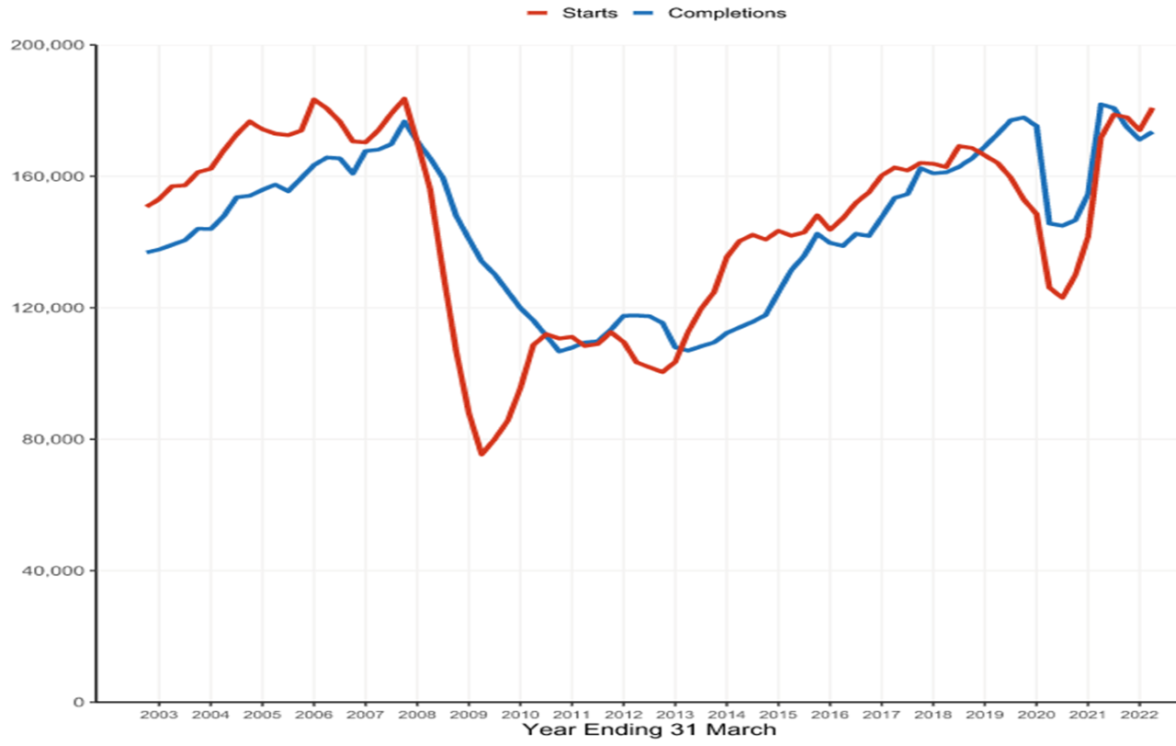
Development 300,000 houses a year

Slide 7
Development Source: DLUHC Live table 213
3 months to June 2022:
Total starts by all developers (54,540) were up 14% on the same quarter in 2021. This was the highest number of starts in the April-June quarter since 1988.
Total completions by all developers (46,250) were up 5% on the same quarter in 2021. This was the highest number of completions in the April-June quarter since 2019.
Housing associations started 8,630 new homes, down 10% on April-June 2021. However, results at June 2021 were a record high. Setting aside April-June 2021, housing association starts were at their highest April-June quarterly number since 1994.
Housing associations completed 8,200 new homes, up 6% on the same quarter in 2021.
12 months to June 2022:
Total house building starts were 180,820 up 5% on the year to June 2021. This was a noticeable uptick, boosted by the strong results for the three months to June 2022.
Total house building completions were 173,530 a decrease of 5% on the year to June 2021. However, total completions were still at relatively high levels.
Housing association starts (31,440) were down 7%.
Housing association completions (31,310) were almost unchanged on the year to June 2021.

Slide 8
Decarbonisation and Building Safety
The Conservative manifesto committed £3.8bn to social housing providers over 10 years.
Social Housing Decarbonisation Fund Wave 2 £800m
Social Housing Decarbonisation Fund Wave 1 £62m and £179m
Hard to heat homes.
Government committed to building safety and protecting leaseholders
carbon monoxide and fire alarms
Continued regulation

Slide 9
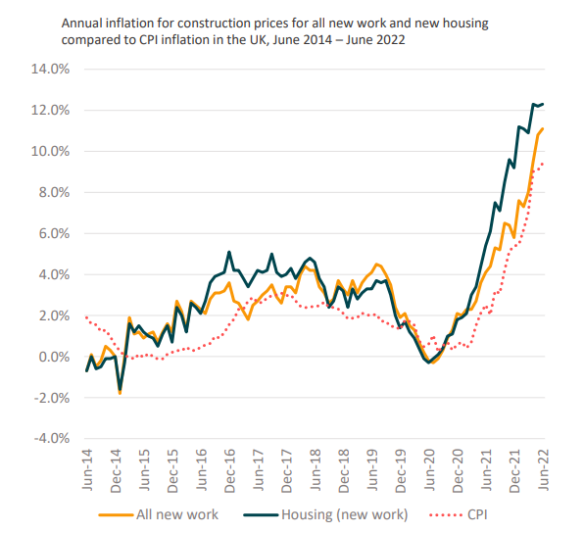
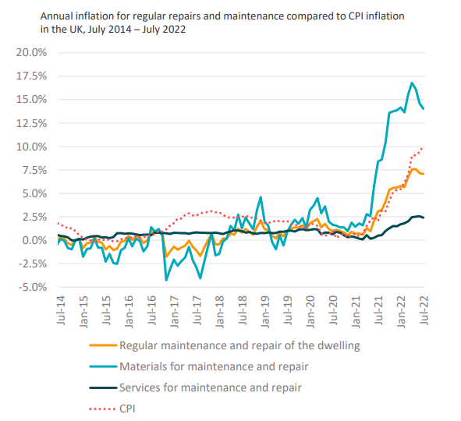
Context – for costs

Slide 10
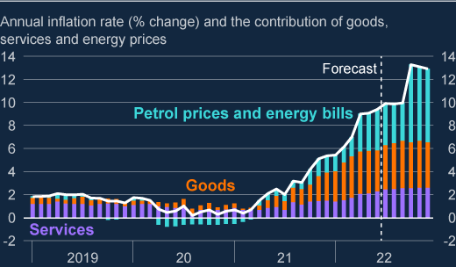
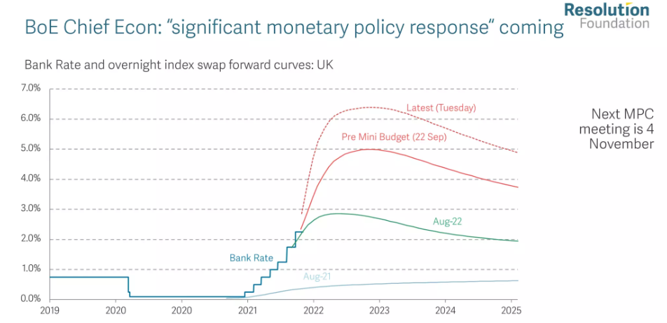
Context – for prices and interest rates

Slide 11
Context – for tenants

Slide 12
Existing rent regulation
Policy set by the government, implemented by RSH
Regulates level at which rents are set on new tenancy, and annual increases (CPI+1%)
Covers social rent and Affordable Rent
Does not cover:
Shared ownership
Intermediate rent
Specialist Supported Housing
Student Housing
Temporary social housing
PFI housing
Care Homes
Viability exemption

Slide 13
Existing rent regulation
Indirectly references service charges:
Affordable rent is inclusive
Social rent – providers should ‘endeavour’ to keep service charge increases within the same envelope
2025 rent policy

Slide 14
Consultation proposals
Closes 12th October
Aim: protect existing social tenants from significant nominal-terms rent increases next year, by capping social housing rent increases from April 2023
Recognises that many providers would not increase rents by CPI+1%
By providing “a backstop of protection for tenants in these exceptional circumstances”
Proposes 3 possible options of caps at 3%, 5%, 7%
Formula rent, relets and new lets continue to increase by CPI+1%
Proposes 1 year cap, but asks about 2
Asks about exemptions (particularly for supported housing)
Recognises impact on sector’s ability to invest in homes and services: “tough choices”

Slide 15
Feedback so far
Boards should retain discretion
Impact of caps at 3 / 5 / 7%
Knock on impact – lending costs, credit ratings, valuation
Agree that formula rent should increase by CPI+1%
One year
Strong case for a supported housing exemption

Slide 16
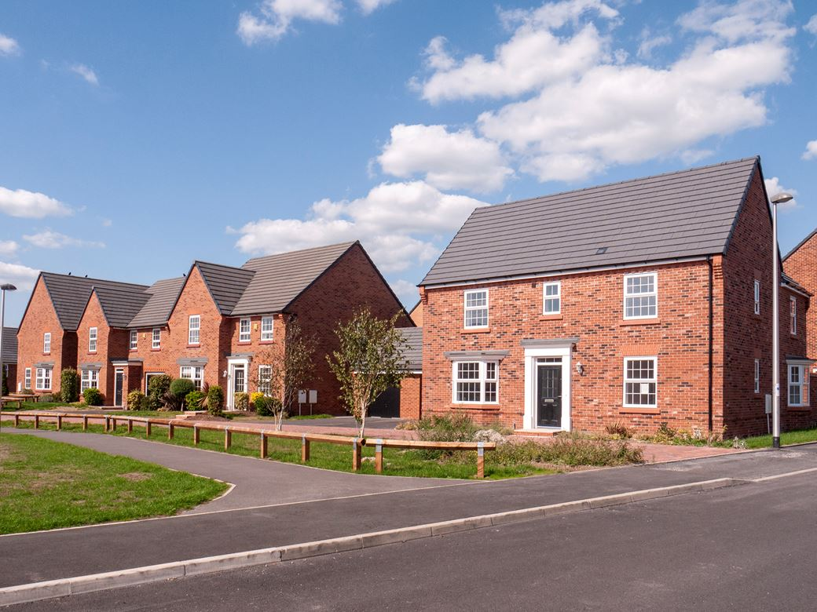
Mitigating measures
Grant funding to fill the short term gap
A ‘catch up’ mechanism (convergence)

Slide 17
Our next steps
Collate member responses and draft submission
Continue briefing MPs, officials and Ministers
Keep contact with key stakeholders – RSH, LGA, charities etc
Media stories on decarbonisation, supported housing
Separate thinking on shared ownership rent increases

Slide 18
Sector purpose
The NHF exists to support members to deliver on their social purpose
Our sector purpose
We provide homes that are affordable to people in housing need.
We provide safe, good quality homes and services.
We offer services that enable residents to live well.
We play our part in building successful places where people want to live.

Slide 19
Sector challenges
We have homes which are not fit for purpose and need significant investment to improve their quality, safety and to reach net zero carbon.
Our performance sometimes falls short of our purpose
Housing need is becoming more acute but also more widespread.

Slide 20
Better Social Housing Review panel
Panel launched as the Better Social Housing Review
Four panel members named in addition to chair Helen Baker
Panel to gather insight through the autumn; recommendations by end of year

Slide 21
Get in touch
Ciarán Tully
External Affairs Manager
Ciaran.tully@housing.org.uk
or EAM@housing.org.uk
Sign up to our NHF news bulleting communications@housing.org.uk
Visit our website for information on webinars and events

